Slide 1
2021-2022
Senior Presentation
Josh Gordon
College Access Specialist
jgordon@bisdtx.org
Sept. 23, 2021

Slide 2
2021-2022 CRCA School Calendar
https://docs.google.com/document/d/1FgOpfh8EVLBeXRJD4GHDdGM6bcimNgg0/edit
people

Slide 3
What will my school week look like?
Seniors are taking classes at an ACC campus Monday through Thursday and are at CRCA on Fridays.
Seniors are enrolled in the following classes for the FALL semester:
•Math 1332 College Mathematics or Math 2412 Pre-Calculus (3 credits)
•GOVT 2305 US Government (3 credits)
•ECON 2301 Principles of Macroeconomics (3 credits)
•BIOL 1406 Cellular and Molecular Biology or BIOL 1408 Biology for Non-Science Majors (4 credits)
people

Slide 4
What will my school week look like?
Seniors are enrolled in the following classes for the SPRING semester:
•TX GOVT 2306 Texas Government (3 credits)
•Biology 1309 Life on Earth (3 credits)
ENGL 2322 British Literature (3 credits)
people

Slide 5
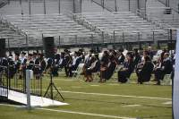
High School Graduation
Mr. Longoria and Mr. Gordon will meet with all seniors to discuss their current academic status.
Seniors need to pass the following classes to satisfy high school graduation requirements.
Government 2305- US Government
Economics 2301- Principles of Macroeconomics
English 2322- British Literature (you will be taking this with Mrs. Sharp)
people

Slide 6
Repeating ACC Courses
The cost of courses/ books that are being repeated because the student withdrew from, failed, or earned a D in the course the previous semester or year, will be paid by the student and their family.
The current tuition ACC charges CRCA students is $150 per course.
Payments for repeated or in lieu of courses, including those taken during the summer, will be made to CRCA and are due by the last day of drop.
people

Slide 7
Satisfactory Academic
Progress
(SAP)
It is absolutely essential that your student maintains or achieves the following in order to qualify for state and federal financial aid for their undergraduate college education:
A MINIMUM of 2.0 GPA
A MINIMUM of a 67% Completion Rate
9

Slide 8

What’s Next?
4 year University
Continue at community college
Trade/ Technical School
Military
Job
Cat has a hat

Slide 9
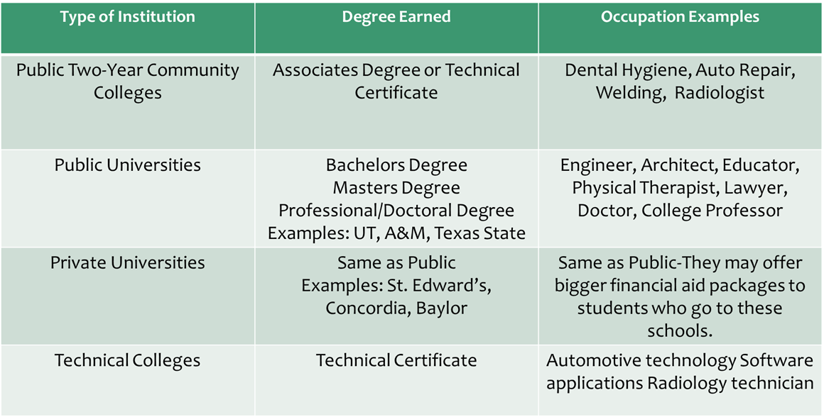
What’s Next?
Cat has a hat

Slide 10
What to consider when choosing a College:
Most Important Considerations:
Location
Size
Program/ Degree Offerings
Cost
Where do you fit in?
Other
Considerations:
Graduation Rate
Housing
Legacy
Religion
Relationship
Cat has a hat

Slide 11

College Tours
You are allowed two excused College Visitation Days.
Try to use these on a Friday, so that you do not miss ACC.
You must complete the College Visitation Form and submit it to Mr. Gordon. It can be found in the Google Classroom or here:
https://classroom.google.com/u/0/w/Mzc2NzkyNzEwOTU1/t/all
Cat has a hat

Slide 12
How Do I Choose A Major?
A major is your primary field of study you plan to get a job in after you graduate, such as engineering, education, or graphic design.
When choosing a major ask yourself:
1.What are my interests?
2.What are the job prospects?Income potential?
3.What is my personality?
Cat has a hat

Slide 13
2020’s 10 Most Popular
College Majors
https://www.bestcolleges.com/blog/most-popular-college-majors/
Business
Health Professions
Social Sciences and History
Engineering
Biological and Biomedical Sciences
Psychology
Communication and Journalism
Visual and Performing Arts
Education
Computer and Information Sciences
Cat has a hat

Slide 14

What Do Colleges Look At?
Grades/GPA/Class Rank
Courses
Essays (essay prompt is in the Google Classroom)
Letters of recommendation
(some will)
Extracurricular activities, awards, volunteer hours
Employment
Cat has a hat

Slide 15
What About the SAT/ ACT?
Many universities are not requiring the SAT or ACT. Getting a good score, however, could help students get in a better school or receive scholarships. I am advising all seniors to take the SAT at least once.
Most colleges will accept either the SAT or ACT.
SAT fee waivers are available from Mr. Longoria. Fee waivers can also be used for college applications. Must be eligible for free or reduced lunch.
Cat has a hat

Slide 16

Top Ten Percent
Admission to public postsecondary institutions in Texas is guaranteed to students who graduate in the top 10% of their class at a public or private accredited high school.
Except for the University of Texas at Austin... UT only guarantees acceptance to the top 6% of the graduating class.
Cat has a hat

Slide 17
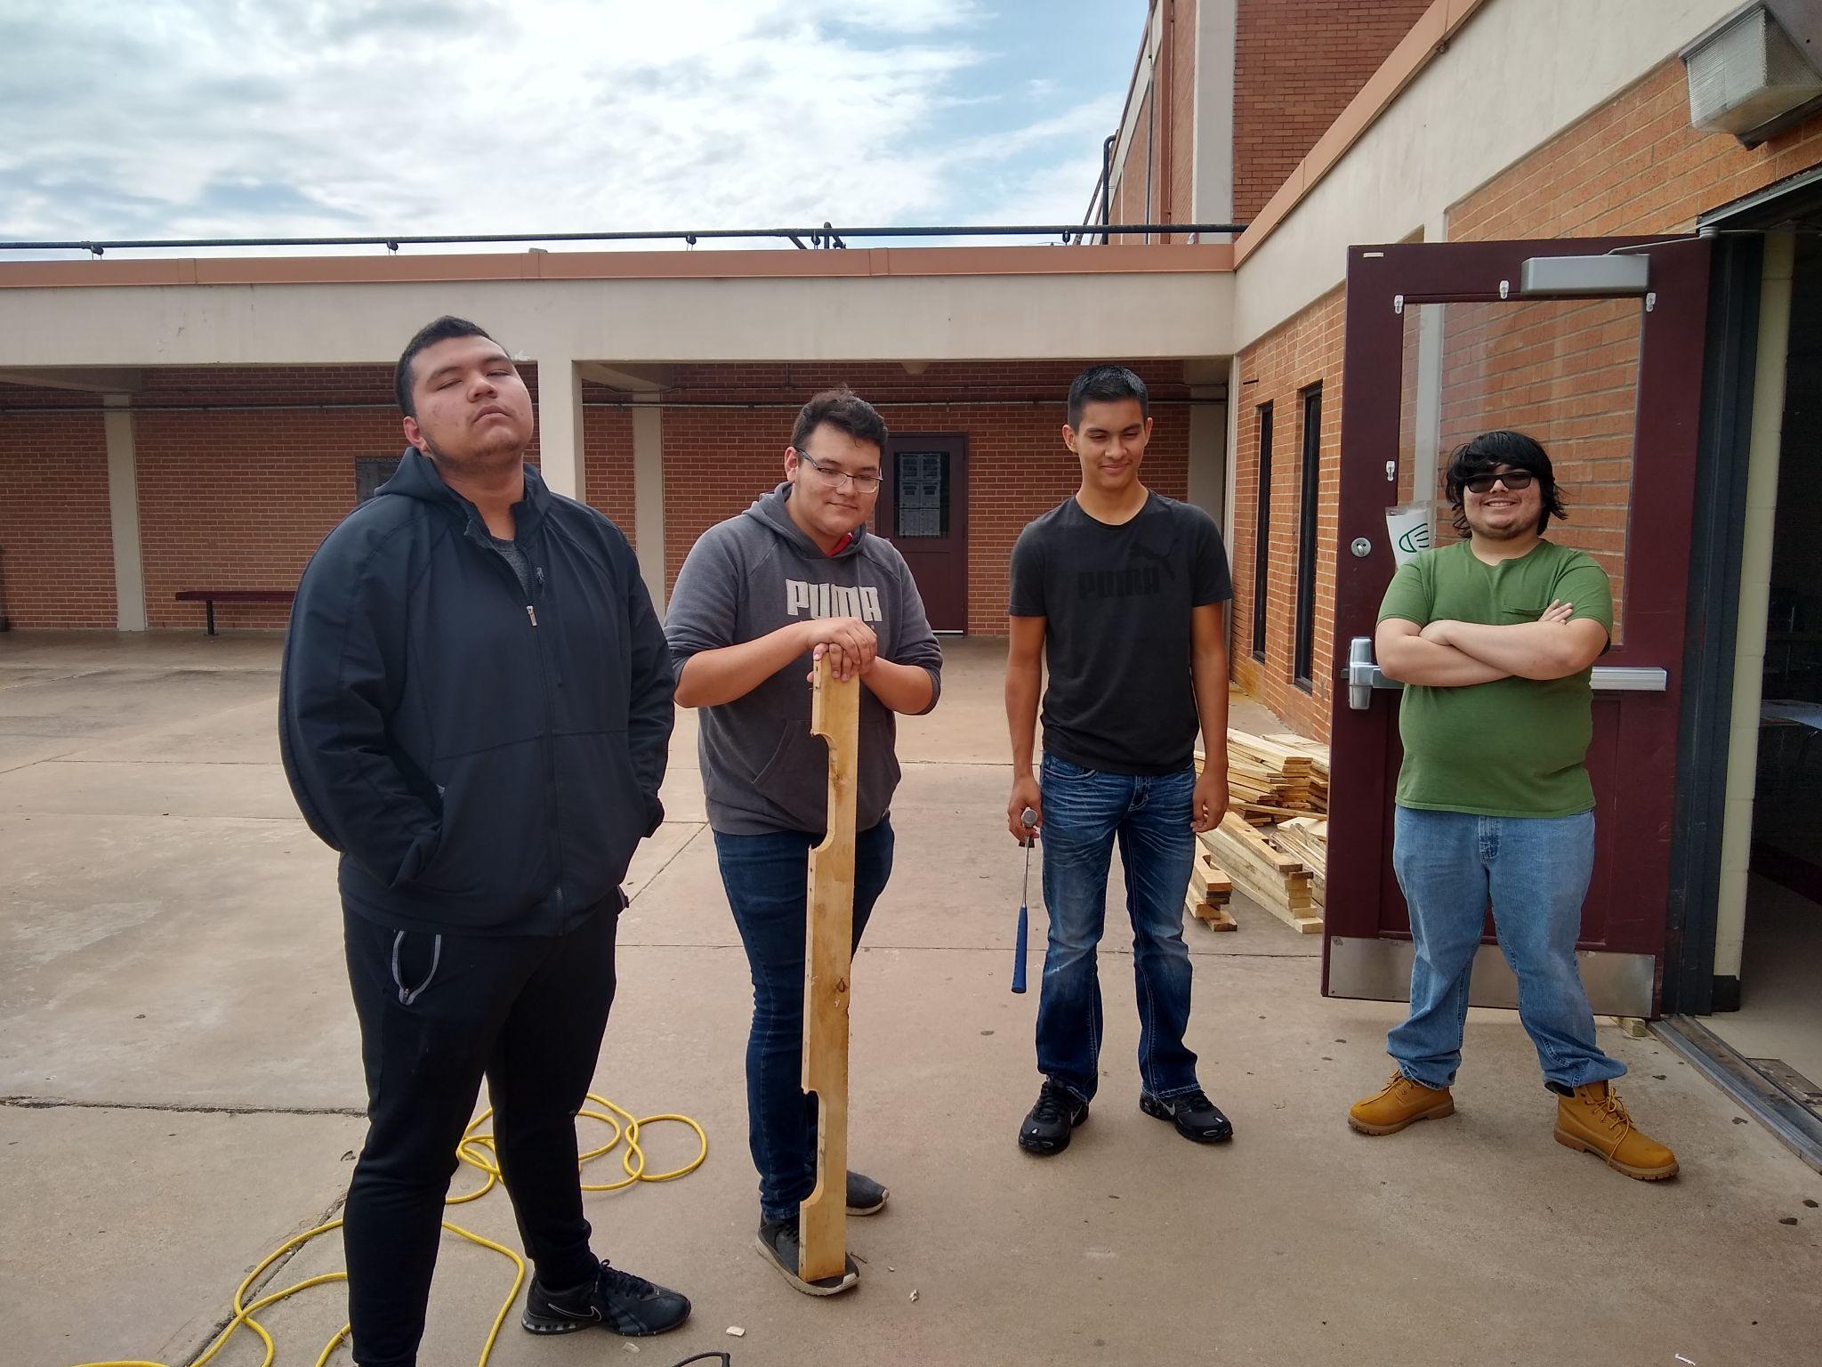
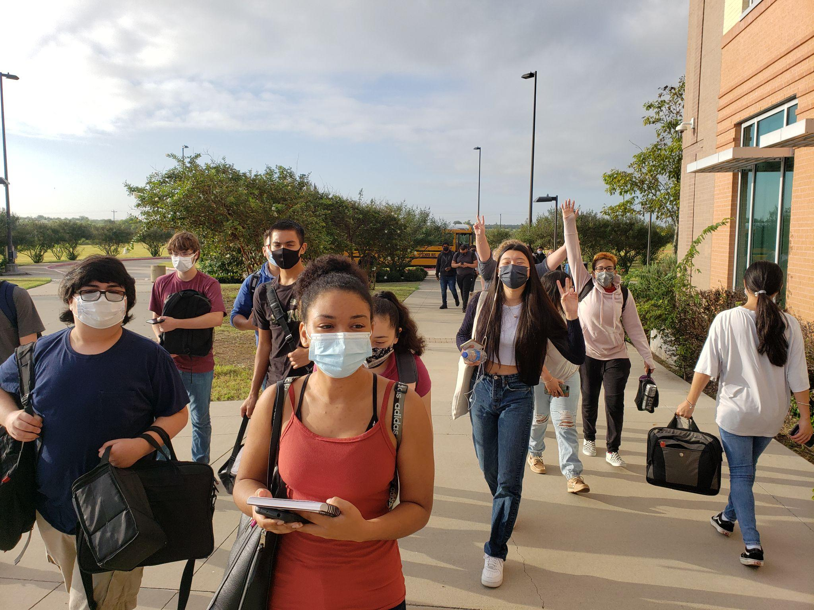
How do CRCA students apply for College
Freshman or transfer student?
You will submit an application as a freshman applicant since you have not yet graduated from high school.
Upon high school graduation, you will work with your college admissions counselor/advisor and they will apply your college credit that was earned while in high school to your degree plan (if it meets their academic requirements)
Cat has a hat

Slide 18
How do I apply to University?
You can apply to most Texas universities using
https://goapplytexas.org/
(This is the new website, not applytexas.org)
For out-of-state universities, you can usually apply using https://www.commonapp.org/
Caution: Out-of-state and private universities may not accept all or any of your college credits.
Cat has a hat

Slide 19
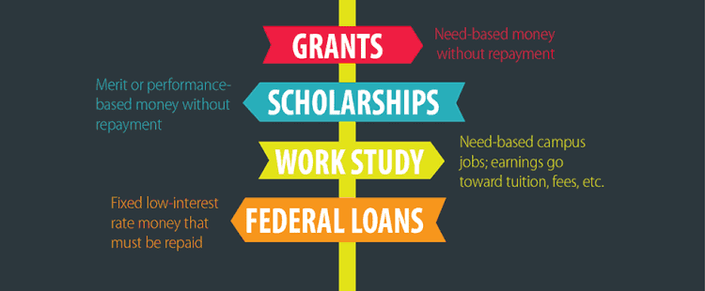
How do I pay for College?
Cat has a hat

Slide 20

How do I pay for College?
FAFSA- Free Application for Federal Student Aid
https://studentaid.gov/
FAFSA goes live on October 1st.
Please join us on
Tues. Oct. 5th from 4:30-7:30 PM
or
Weds. Nov. 3rd from 1-5 PM
for a FAFSA Workshop in the CRCA library.
FAFSA Checklist:
https://docs.google.com/document/d/11dniiWCjnUXdMQomXwHSOlxx5c3h3NNPPEDDzY7Wn4w/edit
Cat has a hat

Slide 21



Types of Federal Loans
LOANS HAVE TO BE REPAID WITH INTEREST
AA
Cat has a hat

Slide 22
Scholarships
Search for scholarships that match your interests and strengths, future major, career, or university, etc.
You can’t get scholarships unless you apply for scholarships.
Here are a few websites:
www.unigo.com
www.scholarship.com
www.collegeforalltexans.com
I will also create a list of local scholarships for students to apply to.
AA
Cat has a hat

Slide 23
THANK YOU!
Are there any questions?
Plan to Attend:
Tuesday, Apr. 26th
Senior Parent College Night
6:30 PM in the CRCA Library
Any Questions please contact
Josh Gordon at jgordon@bisdtx.org
Or
Rick Longoria at rlongoria@bisdtx.org

